Slide 1

FINANCE WORKSHOPS
26th Feb / 3rd March 2015

Slide 2
Introductions
Chair for the day -
Londonwide LMCs team -
Workshop Speakers & Guests -

Slide 3
Format of todays Workshop:
Londonwide LMCs - Scene setting
NHSEL – Issues and financial closure
CQRS – All you need to know!
PH NHSEL – Imms. & Vaccs.
FHS/ SBS - Managing Practice Finances and year end reconciliation
Q&A panel

Slide 4
Todays Aim:
Provide detailed information
Practical support
Answer questions & queries
Gather and take away actions for solutions
Provide follow up FAQ guide
RESOURCE PACK -

Slide 5

No magic wand !

Slide 6
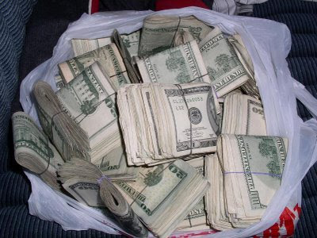
We know what you’re looking for…….

Slide 7


Slide 8


Slide 9
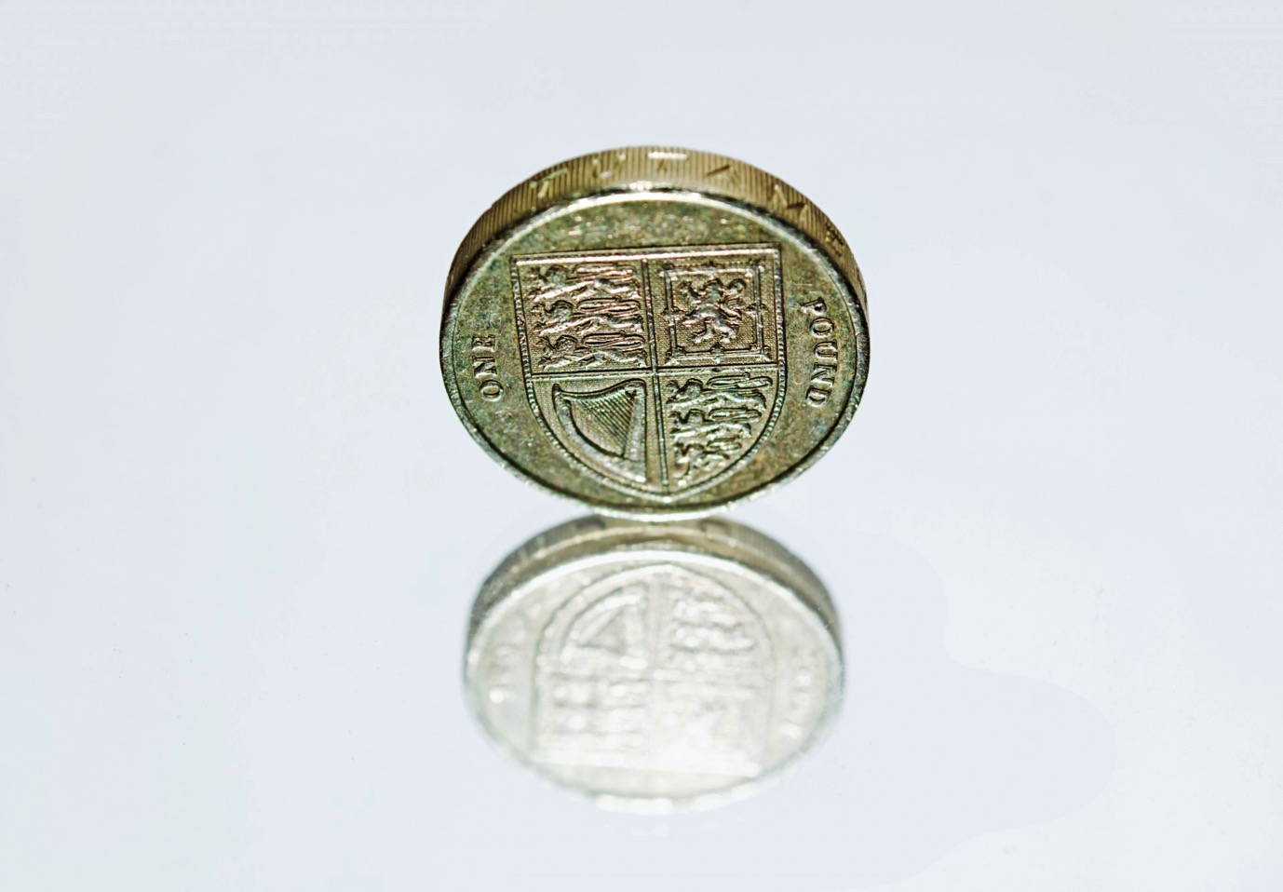

Slide 10


Slide 11


Slide 12


Slide 13
Financial context -
Problematic since NHSEL took over from PCTs
Several payment streams:
  NHSEL ( inc.Flu & Imms)
  CCG
  PH
New National Remittance Advice
CQRS - IMPORTANT
Notes:
This was when the problems really started occurring
Instead of one payee there are now a minimum of three
Even at NHSEL – the vacs and imms payments take a different route to other payments
No one consulted on the new remittance advice style and arguably no one tested it before its release
There is no way changes can be made to a National system
CCG payments are often very unclear and not listed on Open Exeter ( in the separate payments item)
An area to try and improve on!
CQRS – Frequent changes to what it will automatically extract - PMs need to be mindful of these
LwLMCs needs to see if it can create a way of staying abreast and communicating to practices

Slide 14
Taking Action:
Listened to constituents
Set up a generic email to log issues:
pay@lmc.org.uk
Finance working group
Londonwide Directors and NHSEL:
    Julie Freeman
    Jane Betts
    Vicky Ferlia
    Greg Cairns
    Toyin Akinyemi
    Practice Managers
    Tracey Amatt (Surrey & Sussex LMCs)

Slide 15
WORKSHOPS -
Get everyone in the same room at the same time, recognise and understand the difficulties and work out some solutions……

Slide 16


Slide 17
NHSE
London Region
Toyin Akinyemi
Head of Finance – Primary Care Commissioning

Slide 18
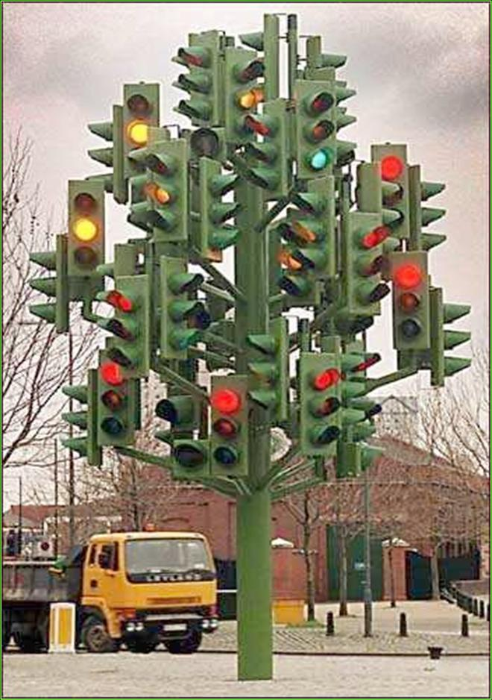
Q&As
Questions from the floor

