Slide 1
Primary Care Support Services
Finance Process For Payments

Slide 2
Payment Streams
Area Team Direct Enhanced Service’s (DES),
CCG Local Enhanced Service’s (LES).
Possibly ceasing from 01.04.2015
Public Health England (Immunisations).
Processed through Exeter.
Statements available through Open Exeter
Interfaced through Integrated Single Financial Environment (ISFE)
SBS transmit all payments for the country and hold and amend all supplier details including bank accounts.
NHS England Payment made 5 working days after transmitting
CCG Payments can take several working days more to clear depending on their payment cycle, contact your CCG Finance team for payment dates.
Seniority and Childhood Immunisation Targets (CIT) are paid at the end of each quarter, CIT payments are 6 months in arrears.

Slide 4
GP’s responsibilities
To informing us of changes to partnerships to ensure correct deductions of pensions, salaried GP’s earnings and any change’s of status.
To check statements on a monthly basis, including splits between CCG and NHS England.
To submit pension estimated forms at beginning of the year. (February)
To submit year end profit certificates in a timely manner. (February)

Slide 5
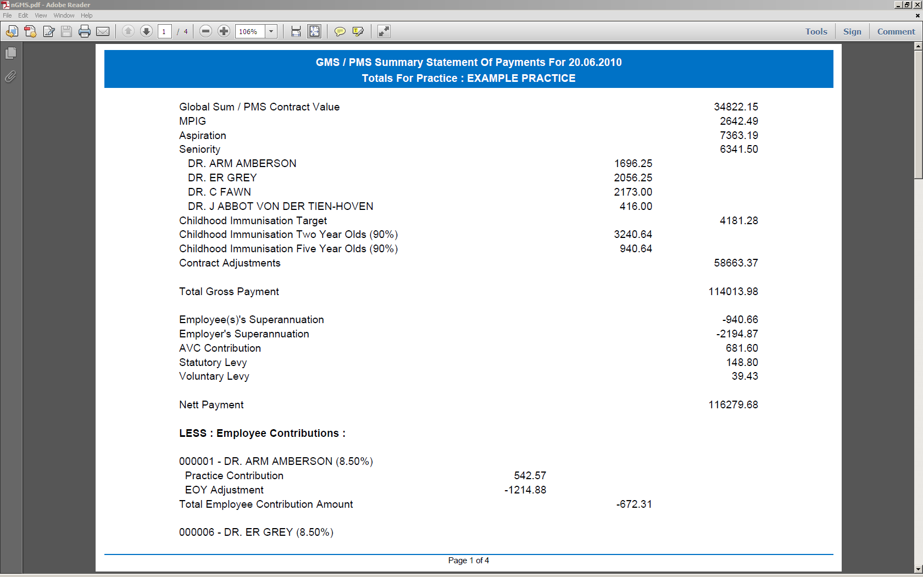

Slide 6
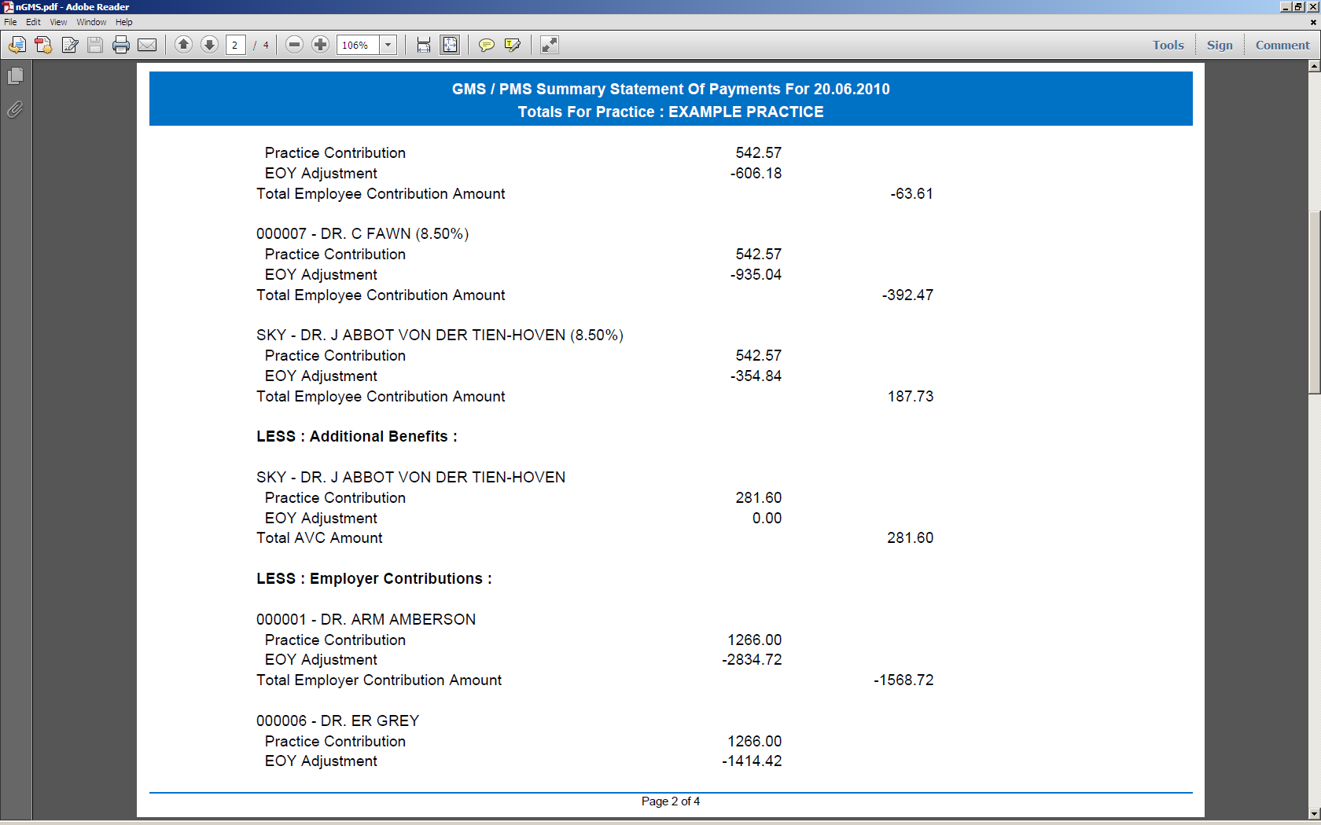

Slide 7
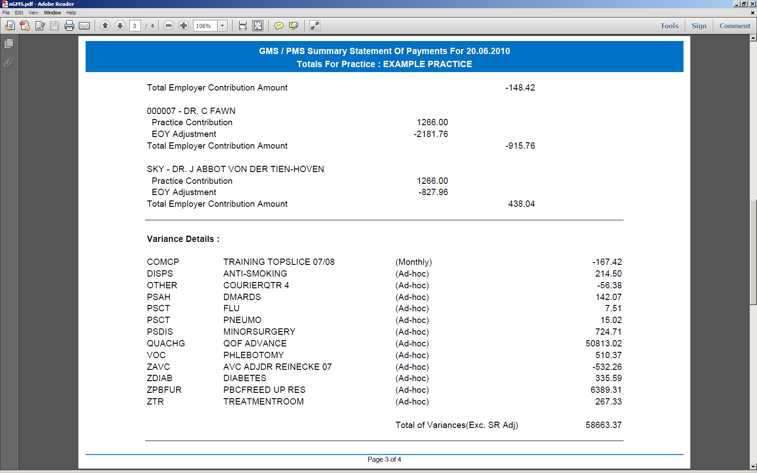

Slide 8
